Slide 1
Classic Hangman
Implementation by Riyan Imam

Slide 2
Details On the Project
What project category does this fall under? This is a combination of both a mystery game and classic game.
How was the game create? Styling was done with HTML/ CSS and some PHP, but logic was all handled by PHP including sessions, server validations, and data processing.

Slide 3
The Lifecycle of the Game
UX/ UI – This should have been simple and to the point, no frills, nothing fancy.
Testing – There was manual testing done throughout the process to make sure elements were in their proper places and looked somewhat decent.
Bugs (or “Addition Features”) – There is at least one bug that is in the actual game page.

Slide 4
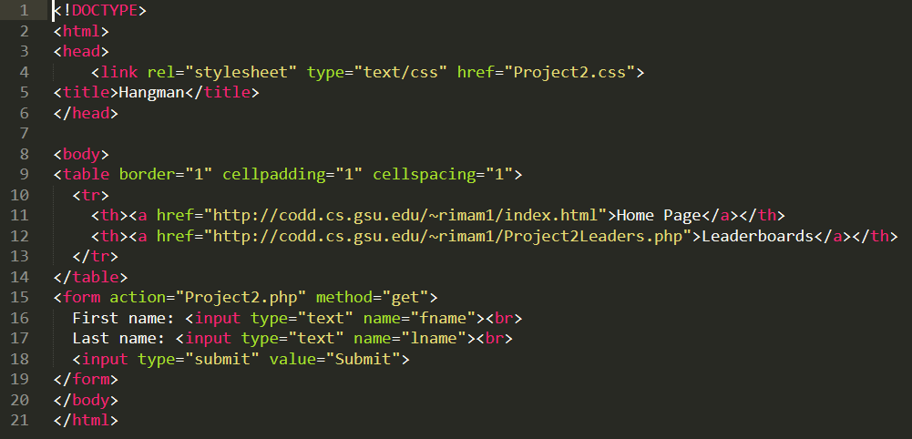
High-Level Creativity
So, for this project, we needed a home page AKA the Sign-In page.

Slide 5
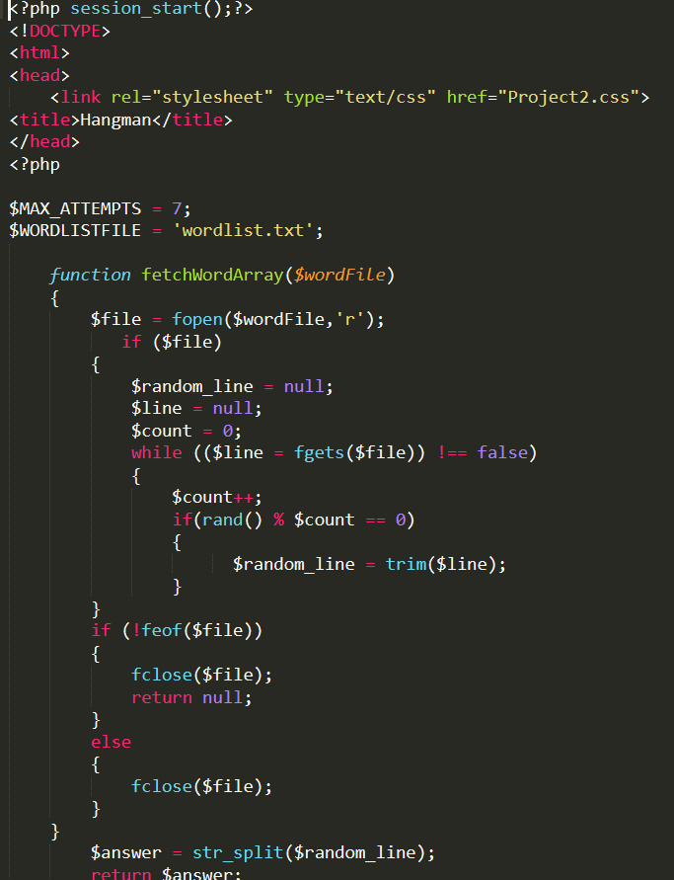
Low-Level Logic
So, the main logic within PHP is used on the actual game. We have 4 key methods in play:
fetchWordArray
hideCharacters
checkAndReplace
checkGameOver

Slide 6
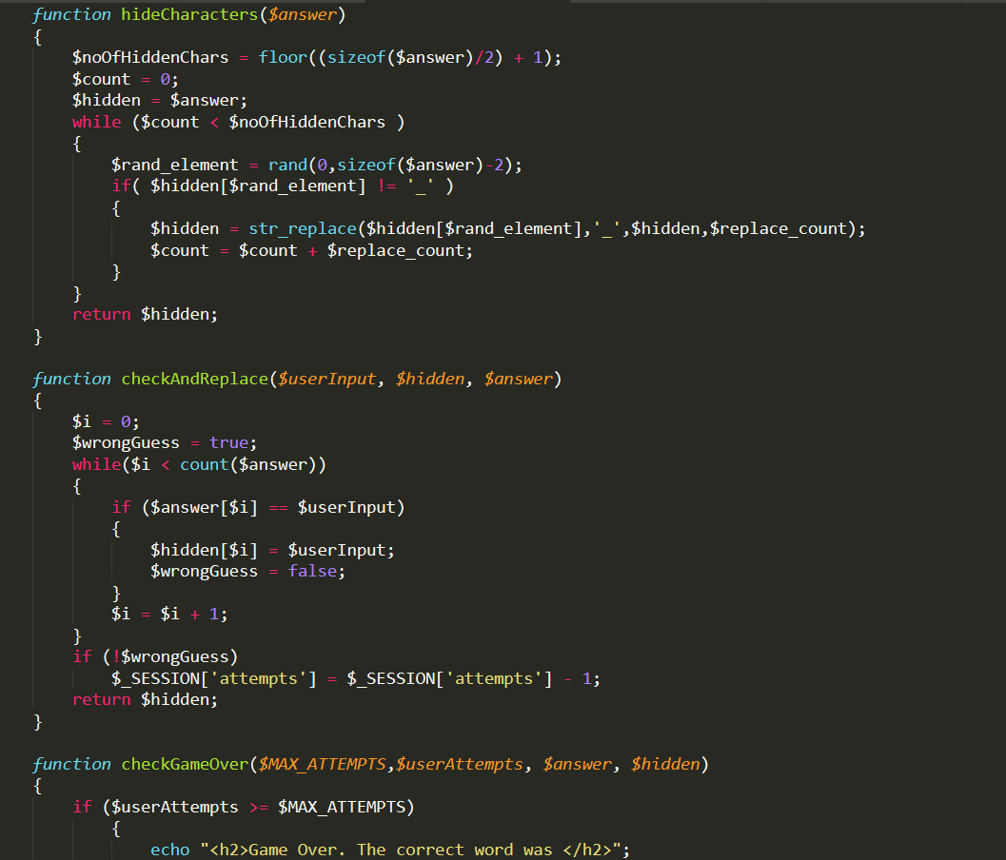
Hiding and Checking

Slide 7
Links
Link to the Project: http://codd.cs.gsu.edu/~rimam1/Project2SignIn.html
Link to the YouTube Video: https://youtu.be/GNAXin1pIdc

